Slide 1
How to Get Your Business the Attention it Deserves

Slide 2
5 Valuable Tips for Marketing Success

Slide 3
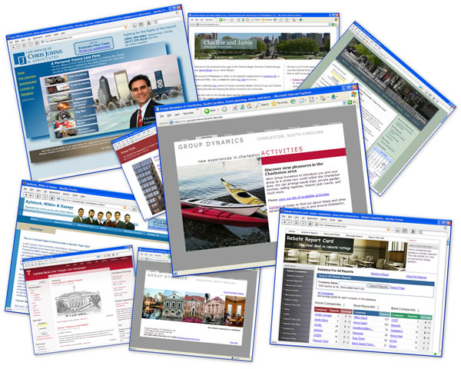
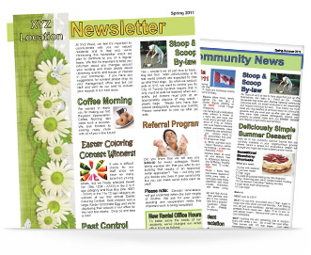
Marketing Vehicles

Slide 4
1. Your Logo is Your Business Signature Get One!

Slide 5
zzzzzzz…
Julie McKinney IACP
Mortgage Consultant Sustainable International Academy
Mortgage Professionals Danville Area of Collaborative Professionals
Honesty. Integrity. Expertise.
WordPower Marketing Vera Wang Images
Ideas. Words. Results. From the Joan Murray Collection

Slide 6
Logos Add Value and Credibility

Slide 7
2. Attention Getting Headlines

Slide 8
Goal Get Target Audiences Attention
* Open your newsletter/email
* Click on a link * Like You on FaceBook
* Contact You * Make a purchase

Slide 9
Spark Their Curiosity
Ask a question: Want to Write Better Headlines?
State a command: Write Better Headlines If You Want More Customers!
Offer a solution: A Better Headline Could Be The Key To New Business
Make a list: 10 Ways To Write Better Headlines
Announce something new: Announcing New Headline Insights
Start your headline with “How to…” (How to write better headlines.)

Slide 10
Newsletters 101
(zzzzz)

Slide 11
How to Get Your Clients to Open Your Newsletters
(!!!!!)

Slide 12
Read On!
The Collaborative Divorce Process
What Does Divorce Have to Do With The Creature From the Black Lagoon?
Managing Symptoms of Menopause
5 Ways to Tame Those Pesky Hot Flashes
Financial Update for the Month of November 2013
Wondering if your Home’s Value is Back Up?
An New Alternative To Botox
New Natural Wrinkle Fighting Serum Gives Botox the Boot
Thinking about a Job Change?
7 Secrets to Ending Corporate Slavery

Slide 13
From zzzz to…

Slide 14
!!!!!...Make Them Want to Read On
Take Your Breath Away Views
Cash is Not King
Pulled Out of a Hat
Has Your Home Value Gone Up?
It’s a Great Time to Make Your Move: Prices are Up and Interest Rates are Low:

Slide 15
Attention Spans Have Hit an All Time Low
(zzzzz)

Slide 16
How to Engage Today’s Faster-than-a-Cheetah Readers
(!!!!!)

Slide 17
How to Engage Today’s Faster-than-a-cheetah-run Readers
Twitter-ers are tweeting.
Facebook-ers are posting.
Pinterest-ers are pinning.
Instagram-ers are picture-taking.
So how do you compete in this
age of bite-sized information?

Slide 18
3. Make Your Content Skimmable
* Keep it concise: 1-5 lines per paragraph
* For longer copy - Chunk it out with subheadings
* Leave plenty of white space between paragraphs
* Highlight key phrases – don’t overdo!
* Mix it up with bulleted, numbered lists, quotes, etc.

Slide 20
4. Promote Your Value to the Client
Your customers want to know…
What’s In It For Me?
What are the benefits to your customer.

Slide 21
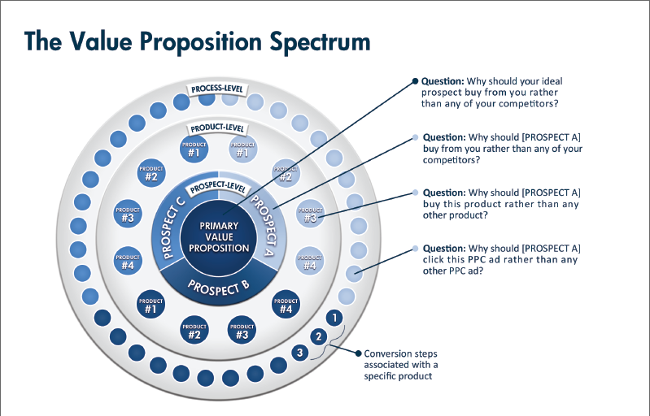
Aka “Value Proposition”
It Simple…
What are the benefits of your product to your customer? Your “Values” will fulfill their needs or desires.

Slide 23
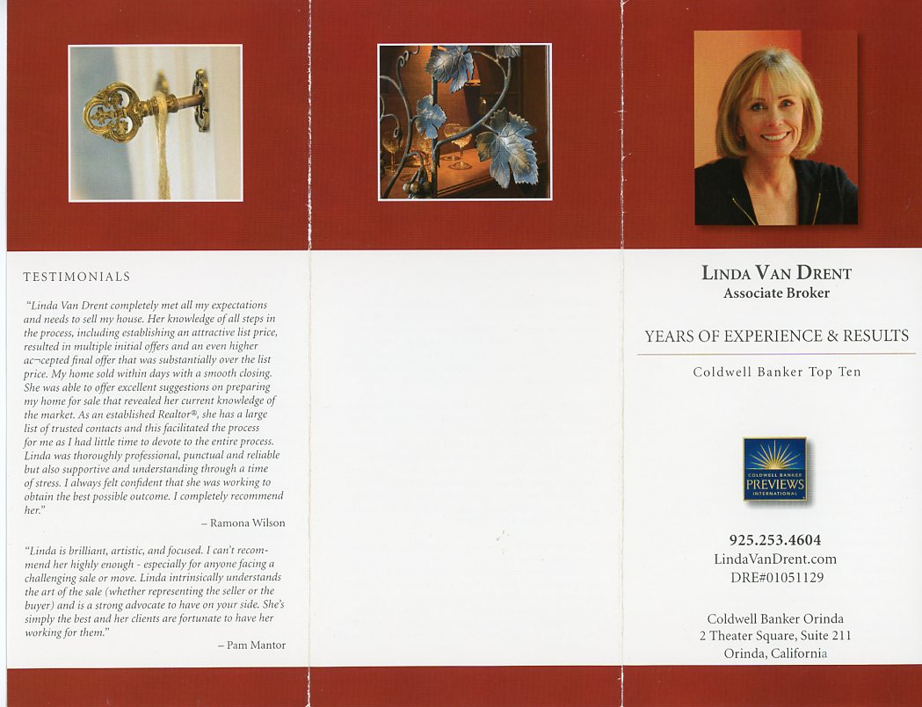

Slide 24
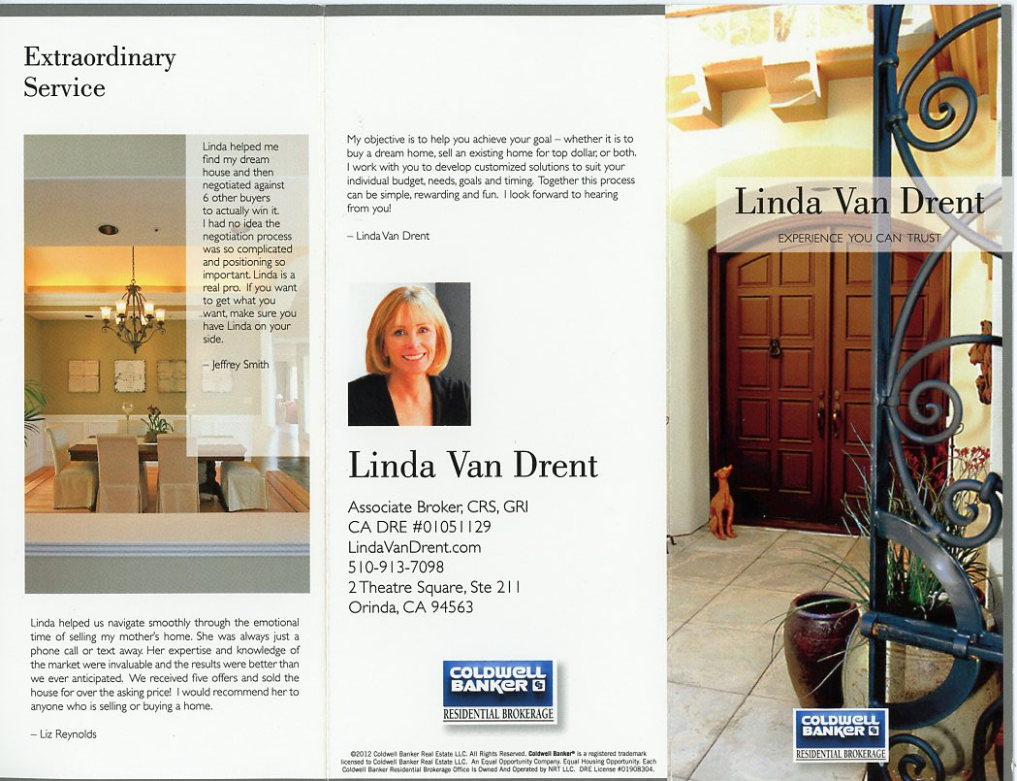

Slide 28
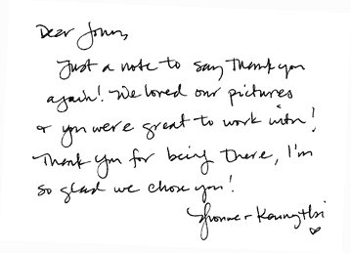
5. Don’t Forget the Personal Touch
Send a handwritten note.
Make a phone call.
Follow-up.
Satisfied Customers and Word-of-Mouth Advertising are Invaluable to Your Business

Slide 29
6. Bonus Tip: Need Help? Call Me.
Have you been meaning start a newsletter or just write that next one?
Did you write your last blog last year?
Thinking about creating a website or starting a FaceBook page for your business?
Wondering what a logo will cost?

